Slide 1

AHOY Our Seafarer’s APP Let us connect

Slide 2



DOC Holder Manage Ships
Technical Support
System Support
CMS Support
Provide Manpower

Slide 3
A bit of history– And NOW…
Data Managed Separately – On Ship and Shore separately
Changed to data Synchronization Between Ship and Shore ( Ship plam )
And NOW
Seafarer
AHOY
SYNERGY SAIL
Ship
Shore
APP CENTRAL

Slide 4
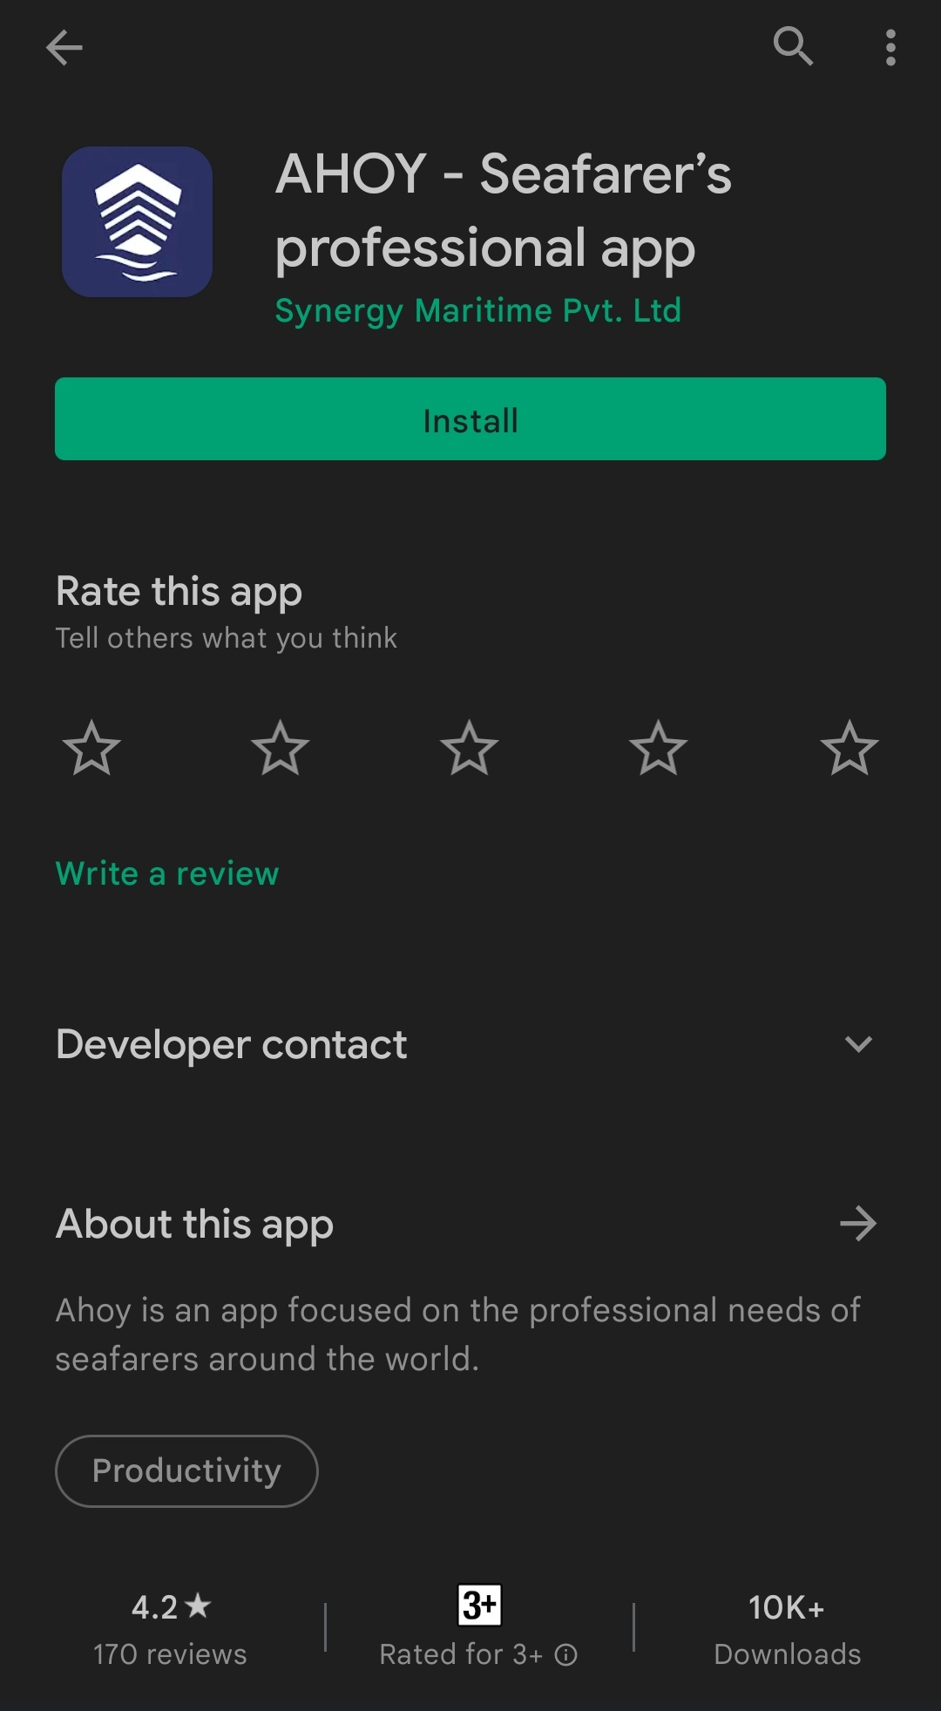
Register
Download AHOY App from APP store or Play store
https://play.google.com/store/apps/details?id=com.synergymarine.wave

Slide 5
Login Process:
Click on Don’t have an Account? (If you are login first time)
Country
CDC Number
Full Name
Email Address
Phone Number
Click on Register and Set Password
UPLOAD CV *
Click on Confirm
Verify through OTP

Slide 6
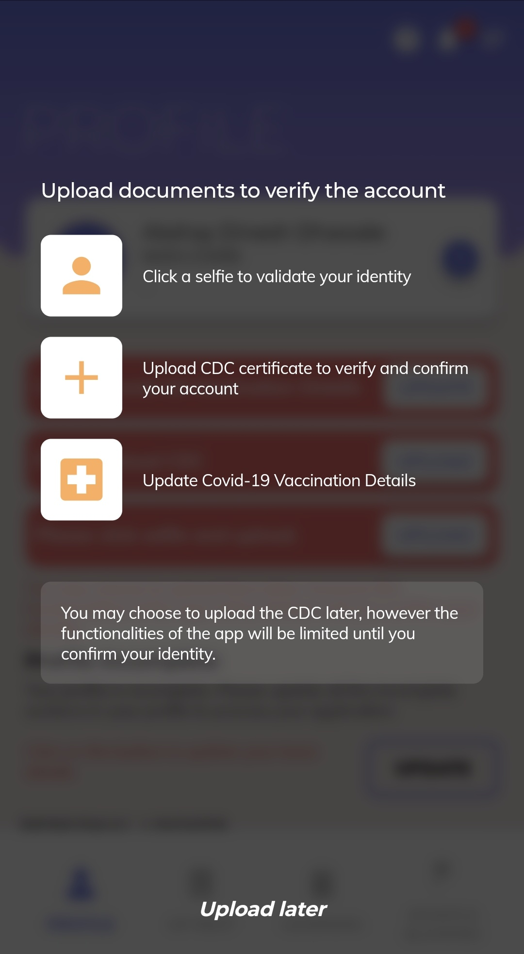
Upload CDC , Vaccination, Selfie– To authenticate
Selfie – to authenticate the person
CDC for checking if you are seafarer
Vaccination – Present Challenges

Slide 7
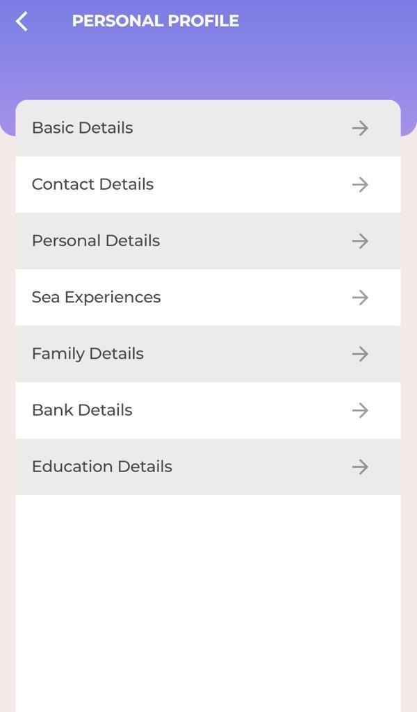
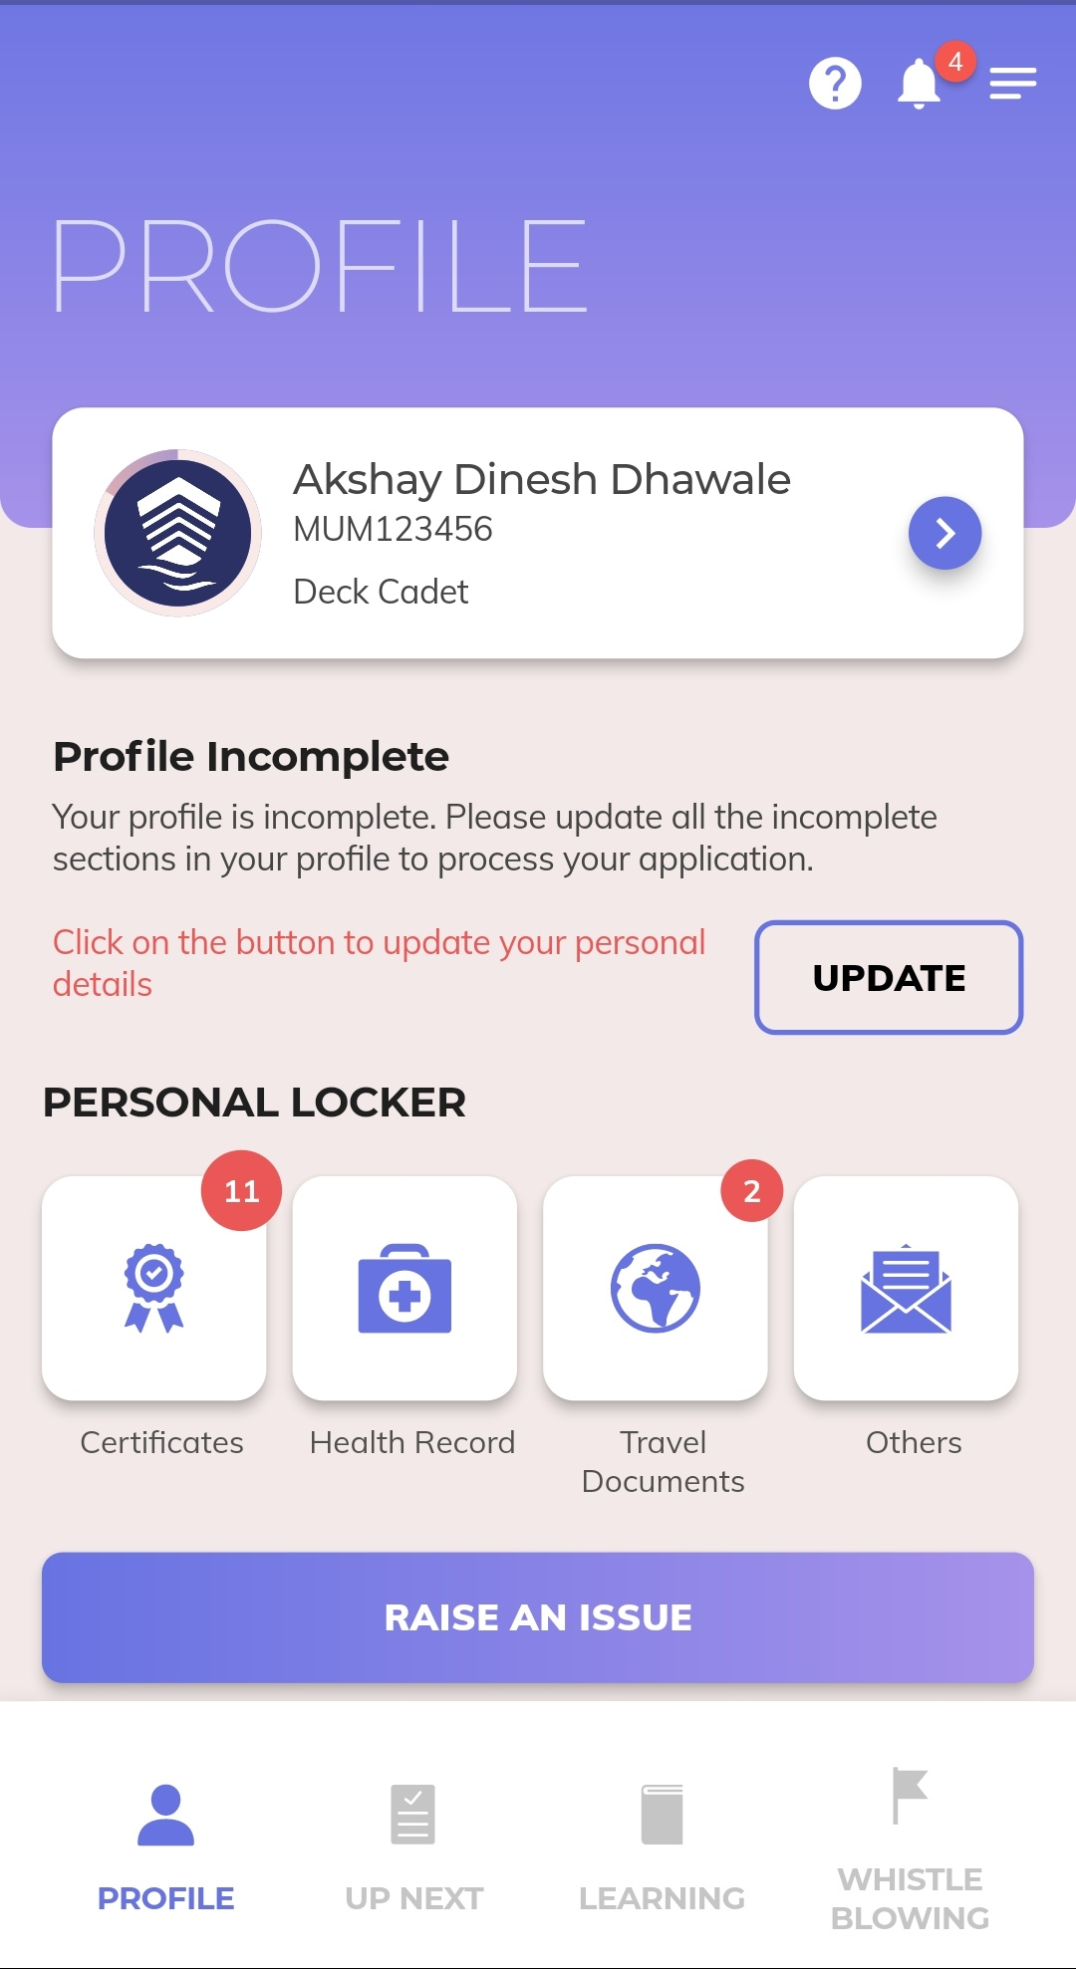
Profile - More Details –Better for all
Suitability
Correct Contact
Sea Experience
To Help Family

Slide 8
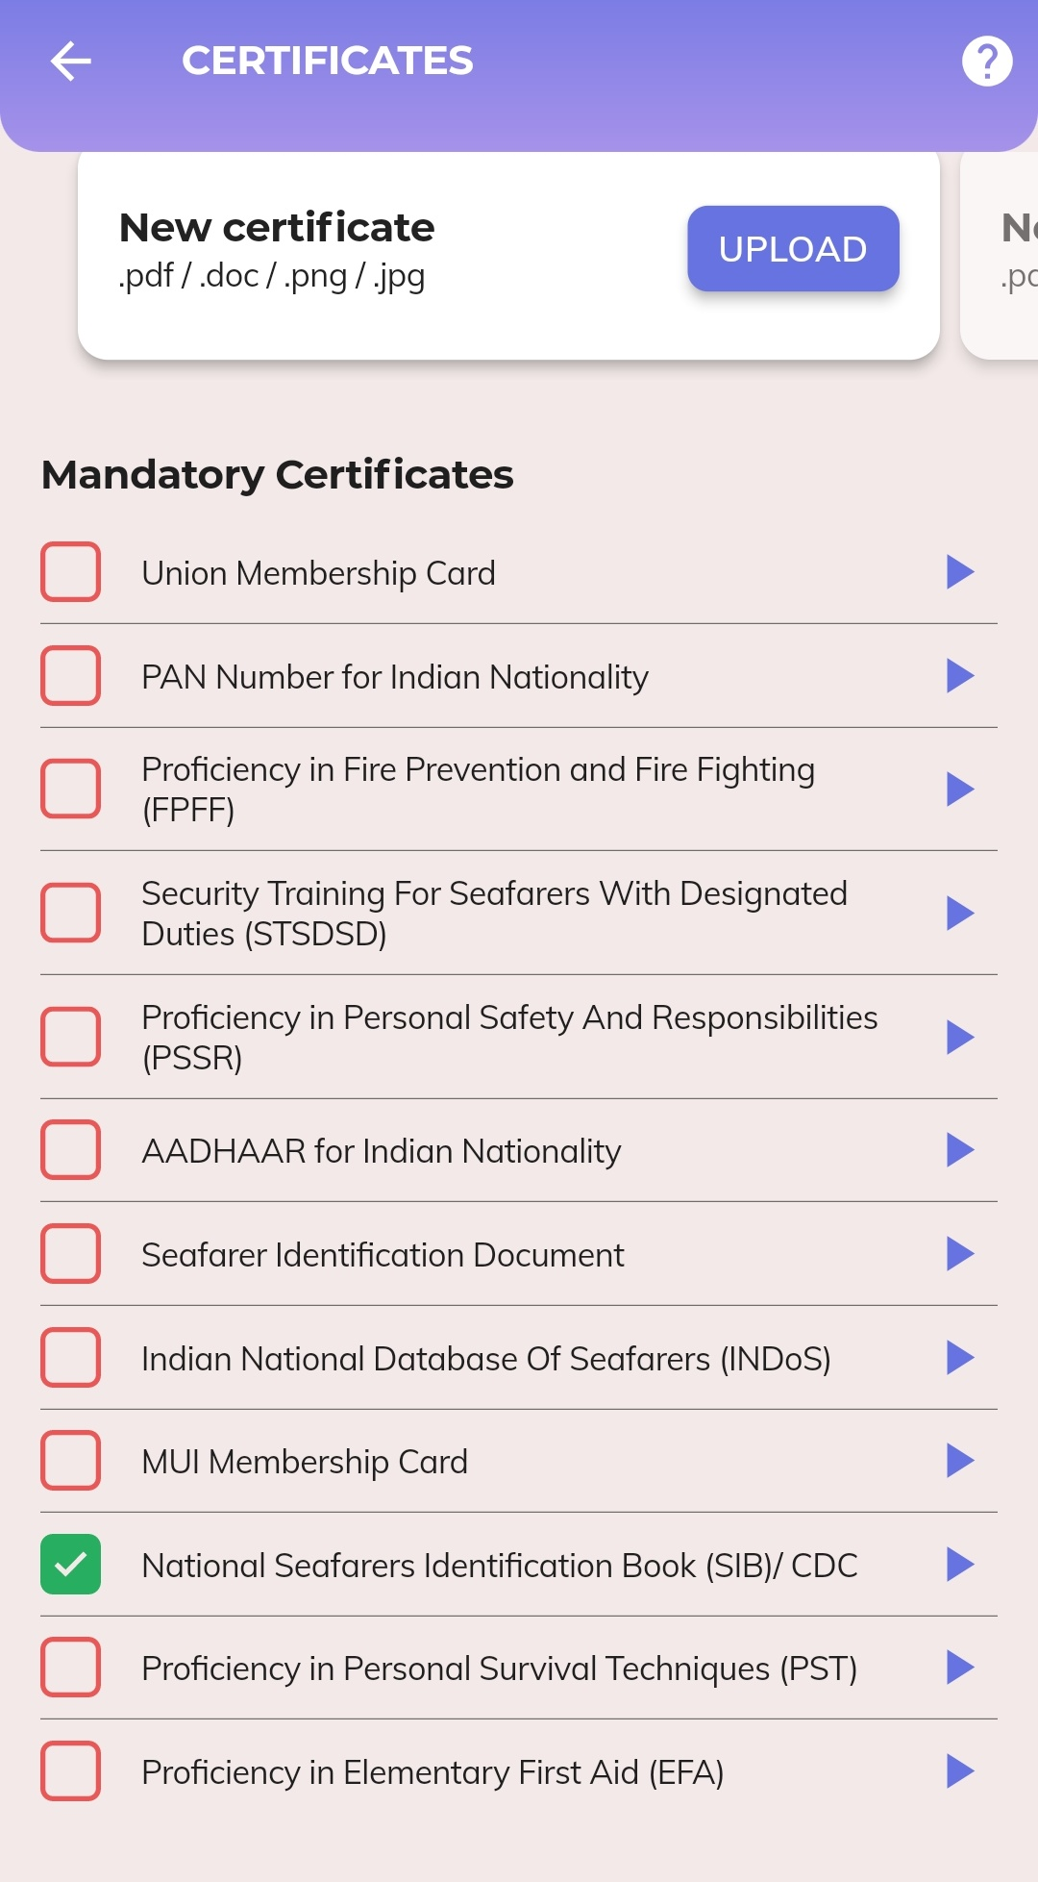
Certificate
If you have other than Mandatory Certificates kindly upload here by searching document name

Slide 9
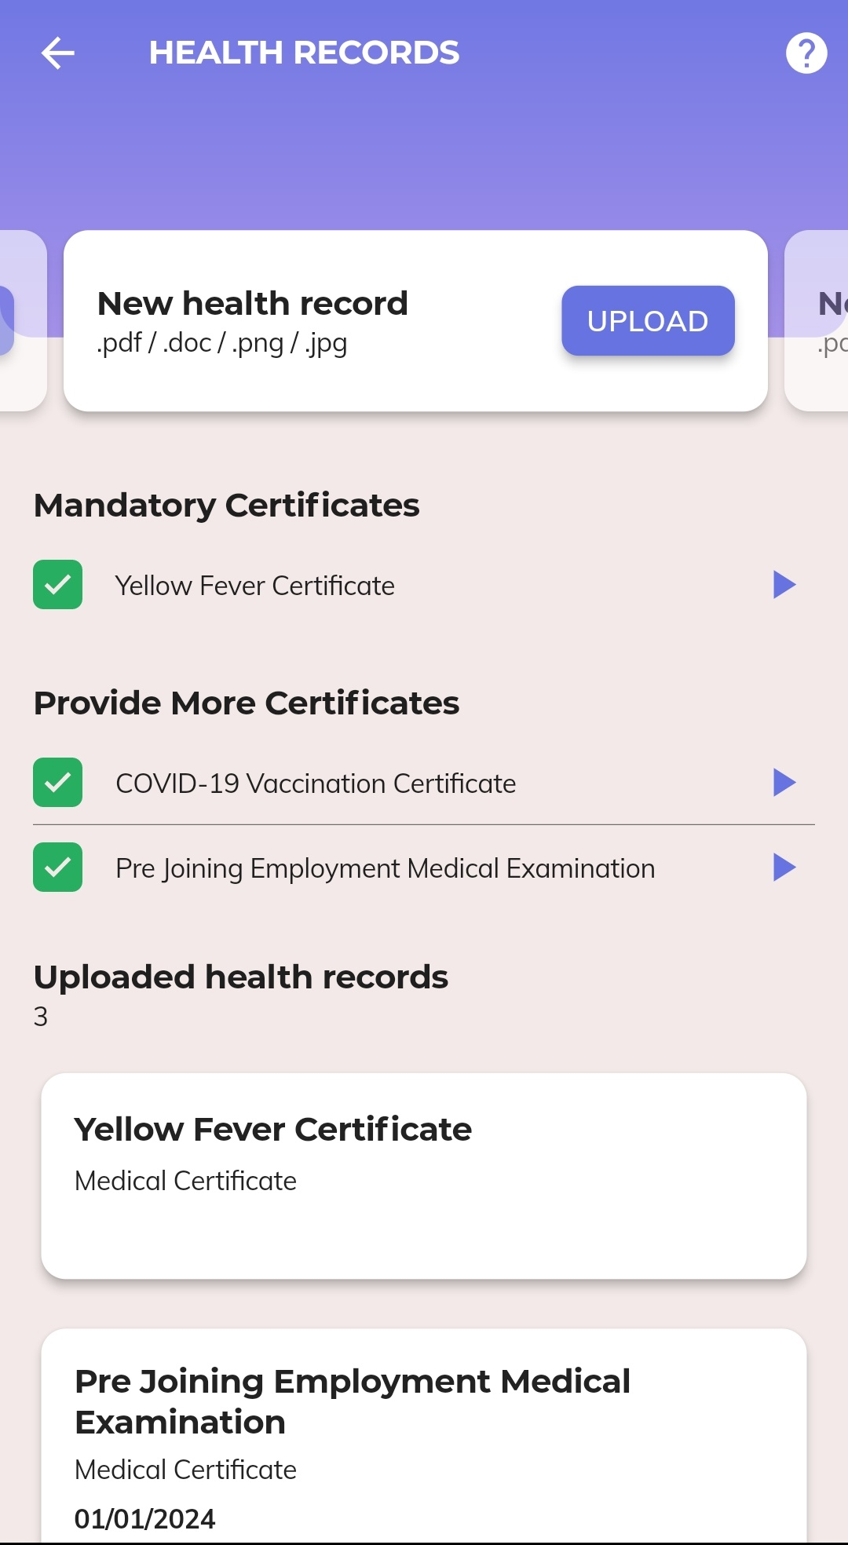
Health Record
If you have other than Mandatory Certificates kindly upload here by searching document name

Slide 10
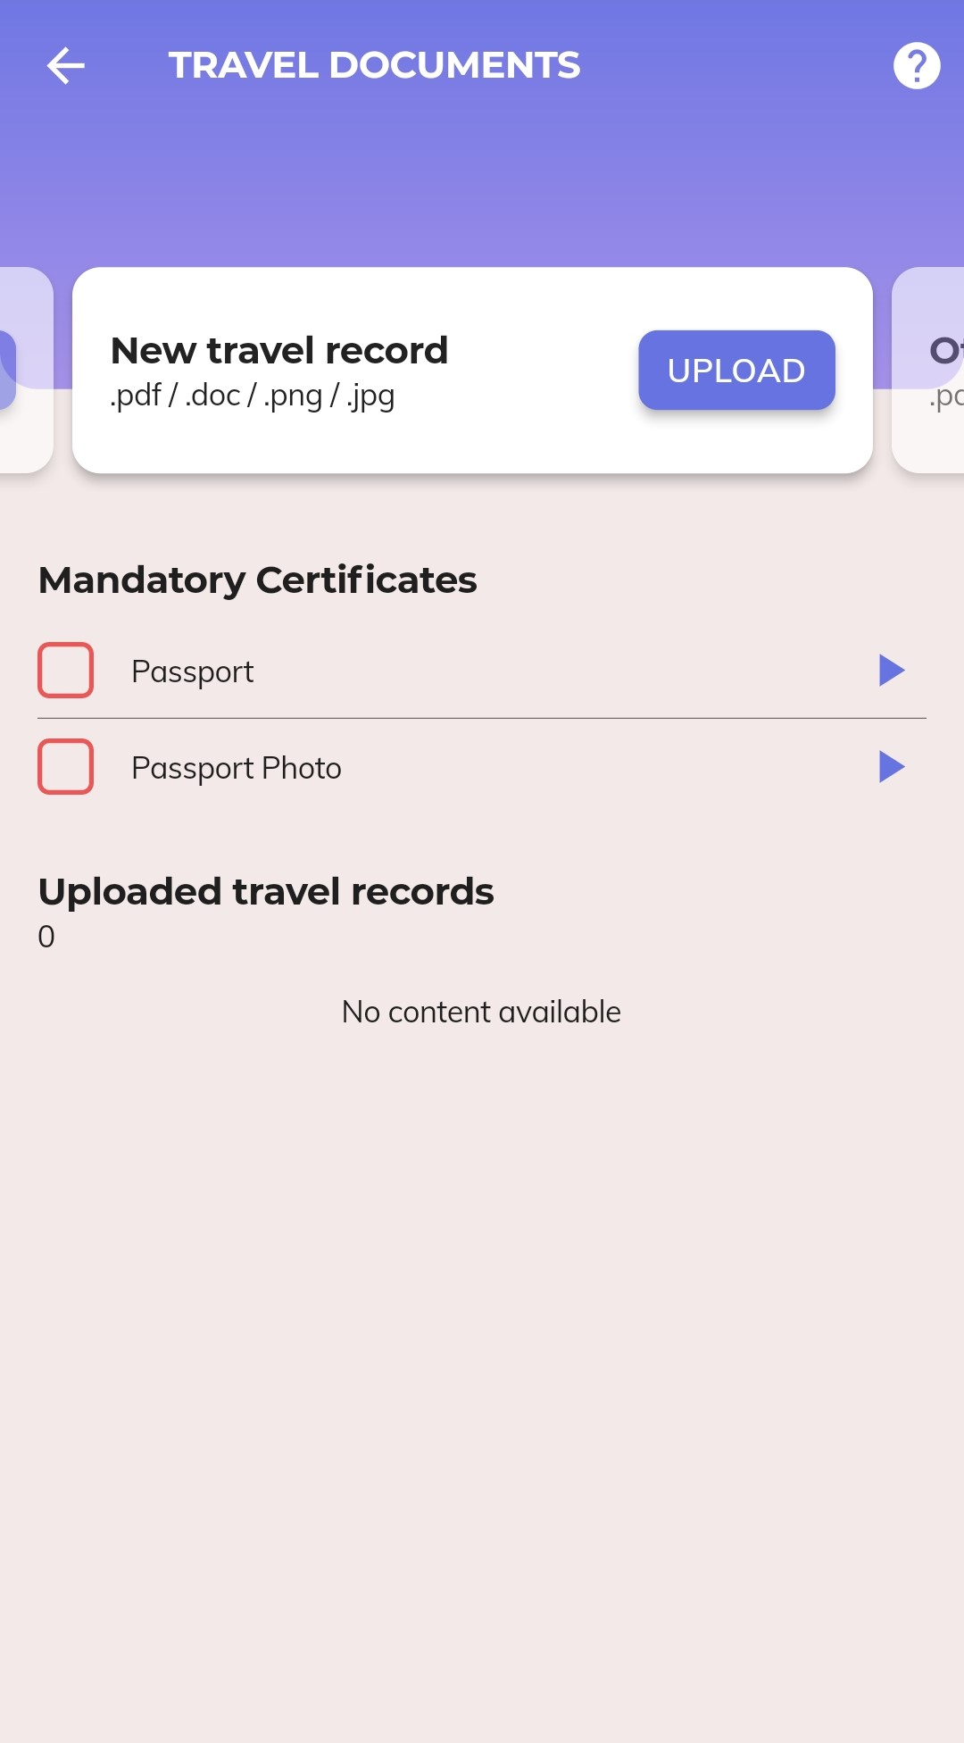
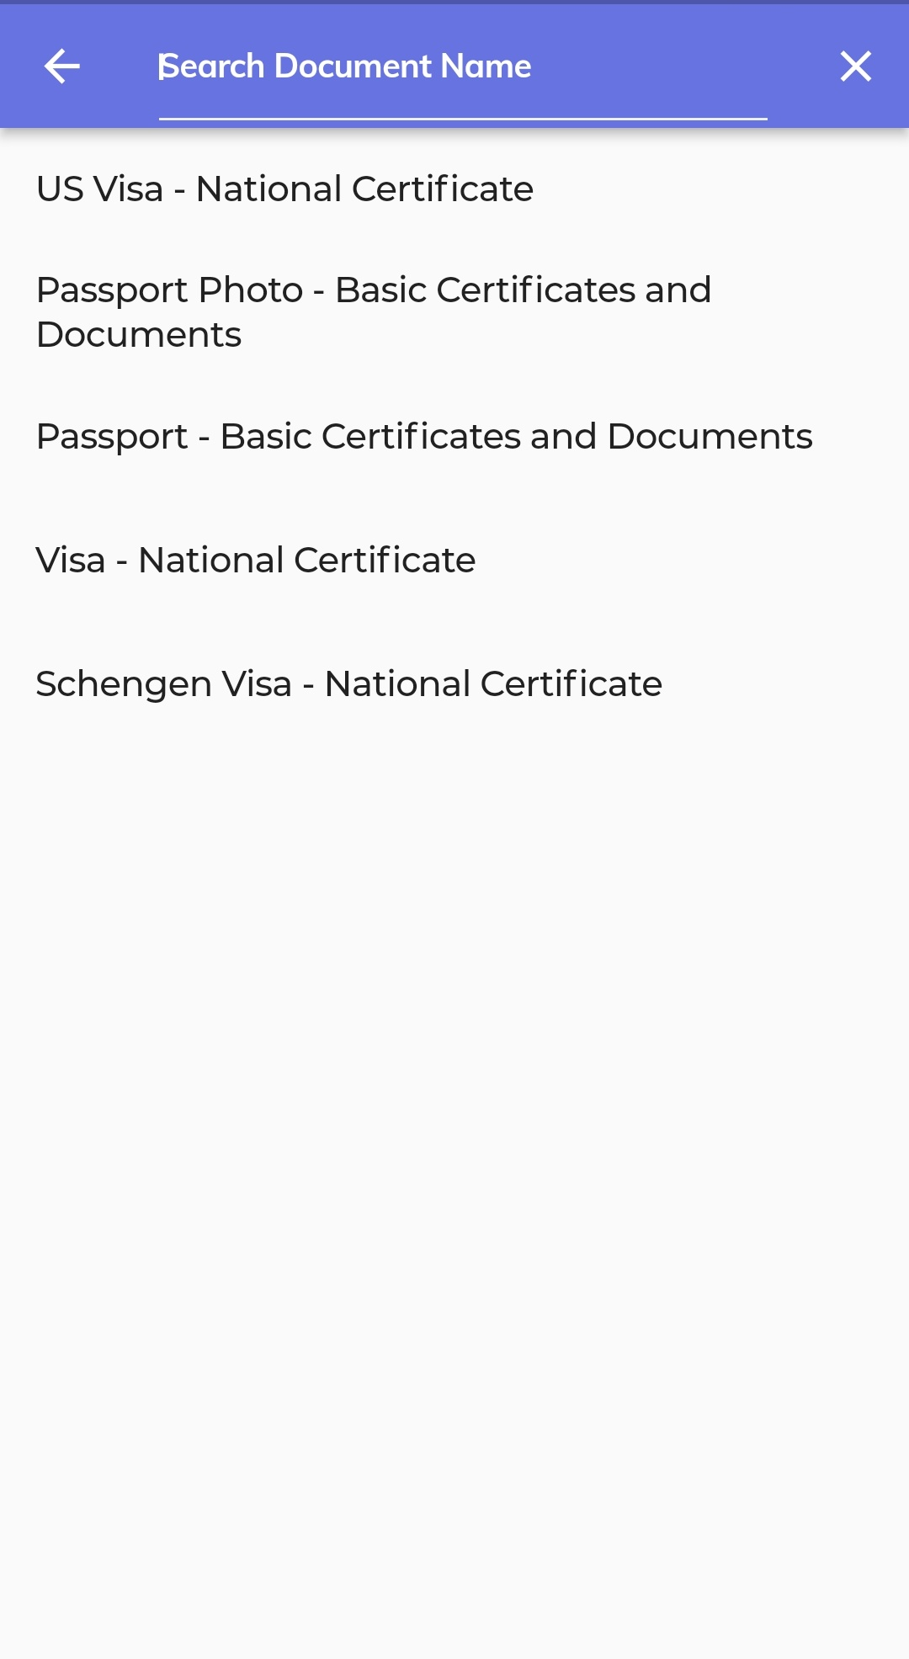
New Travel Record
If you have other than Mandatory Certificates kindly upload here by searching document name

Slide 11
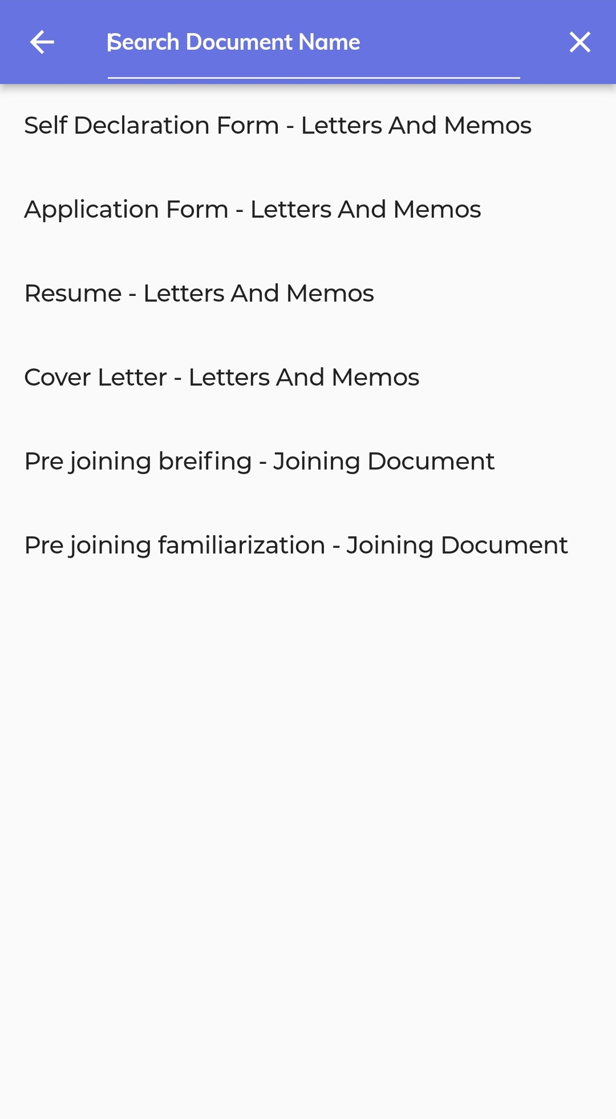
Others -
Kindly upload here other documents by searching document name

Slide 12
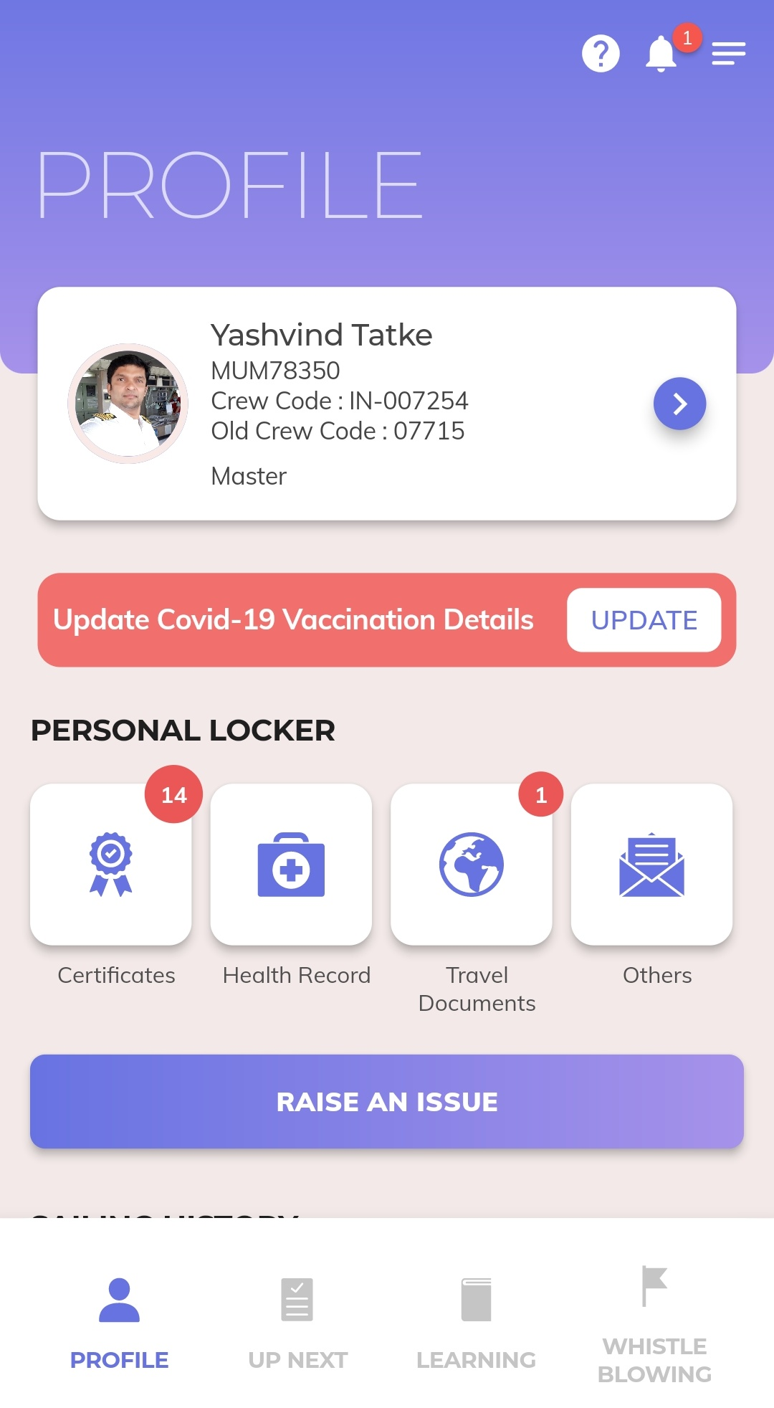
Selected or Profile Verified
Upload all the Certificate and Verify it
Once verification done, after that crew code will be generated.

Slide 13
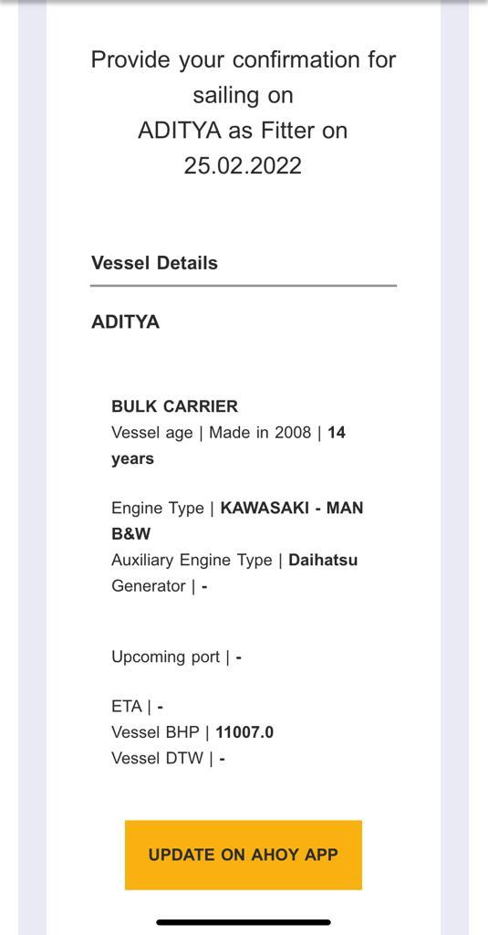
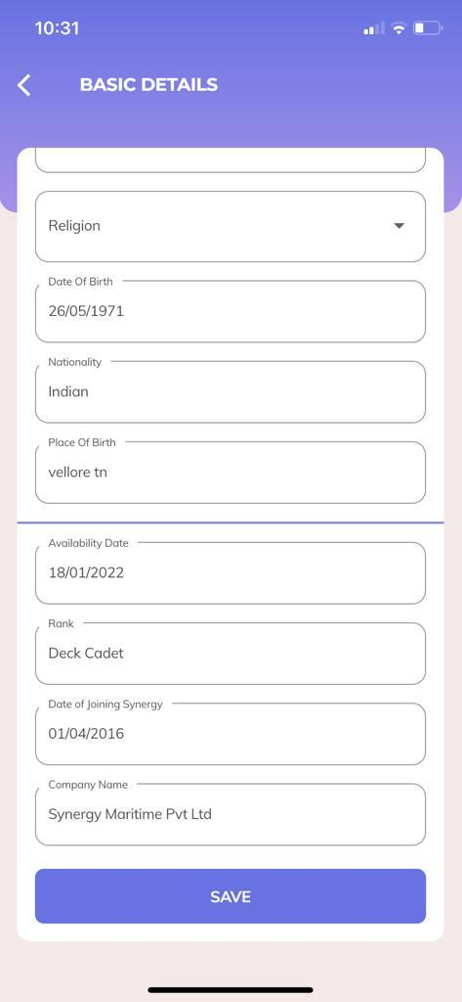
Match request and availability

Slide 14
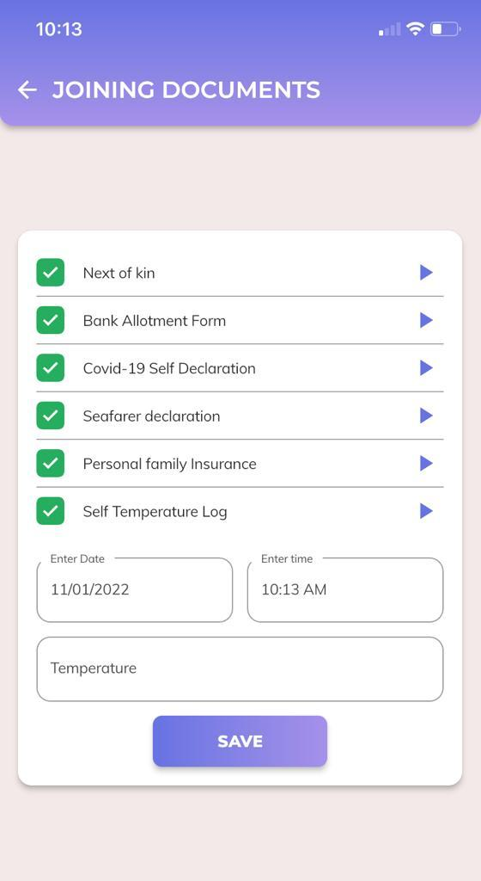
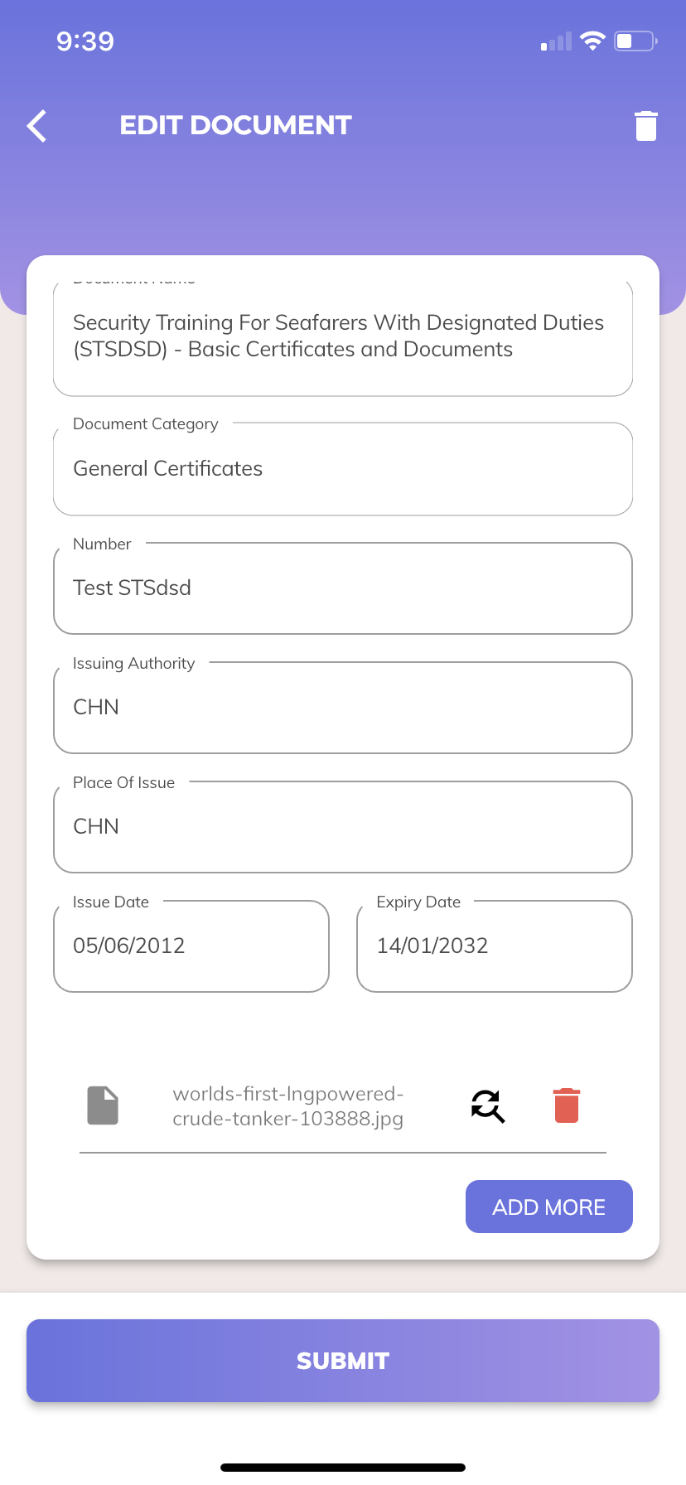
Completion of Joining Documents/ Check Docs

Slide 15
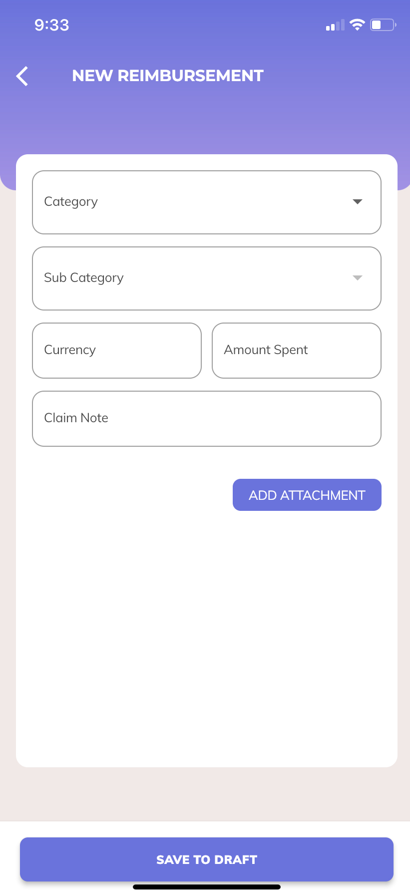
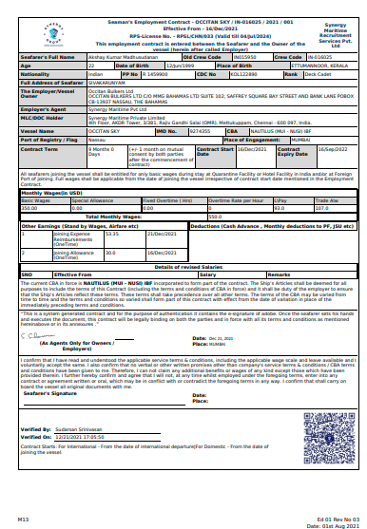
Reimbursement /contract Signing

Slide 16
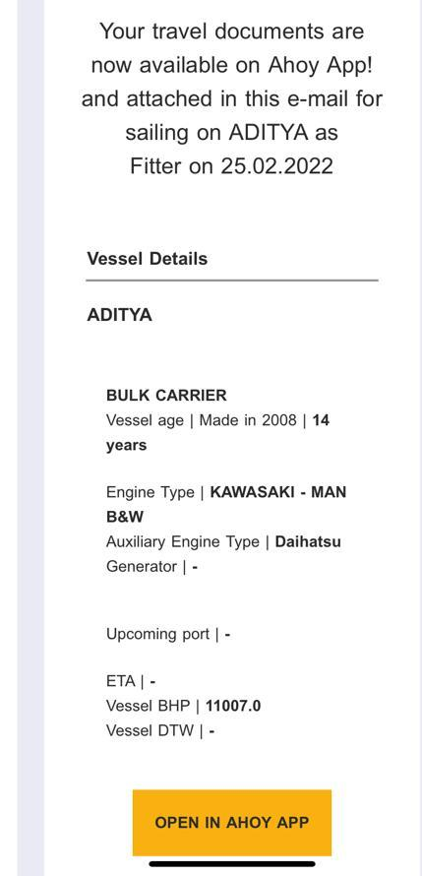
Travel Documents
Ticket
Visa
OKTB
LOG
DG letter
Contract

Slide 17
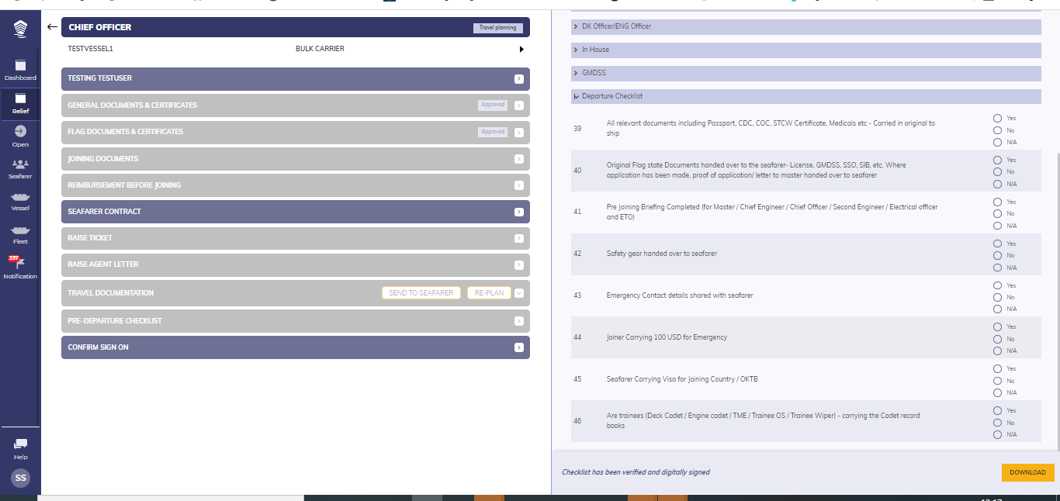
Dep Checklist

Slide 18
So .. What are you supposed to do in AHOY app
Register – with CDC , Photo
Update Vaccination cert
Upload all Cert – STCW, Tanker and DG , Union membership Card , SID , Aadhar , passport , CDC ,
VISAS – US and other visas
Flag Documents
Any other additional cert
In house training Cert
Personal details – Boiler suit , Shoe size, NOK , bank

Slide 19
Check
Data transferred from Ship palm
Sea service experience ,
In house training Cert
Family details
Account details etc

Slide 20
Complete / Update
Availability
Updated certificates
Joining Documents – NOK, Temp Log , Account details , Insurance form , declarations
Sign contracts
Complete Dep Checklist – docs , safety gear etc

Slide 21
Going Forward
Synergy sail App – Portage bill , BOW directly to AHoY , Updating Reimbursement
Training Updates
Mentoring Program

Slide 22
We Will Succeed only when..
We all Use this app
Share the Information in a Common platform
Most importantly Believe on this system

Slide 23
APP CENTRAL

Slide 24
APP Central Main features
Seafarer
Relief Planner
Vessel – Particulars , Crew List Etc
Fleet – Make you own fleet
Configure – wage structure
Configure – CBA details

Slide 25
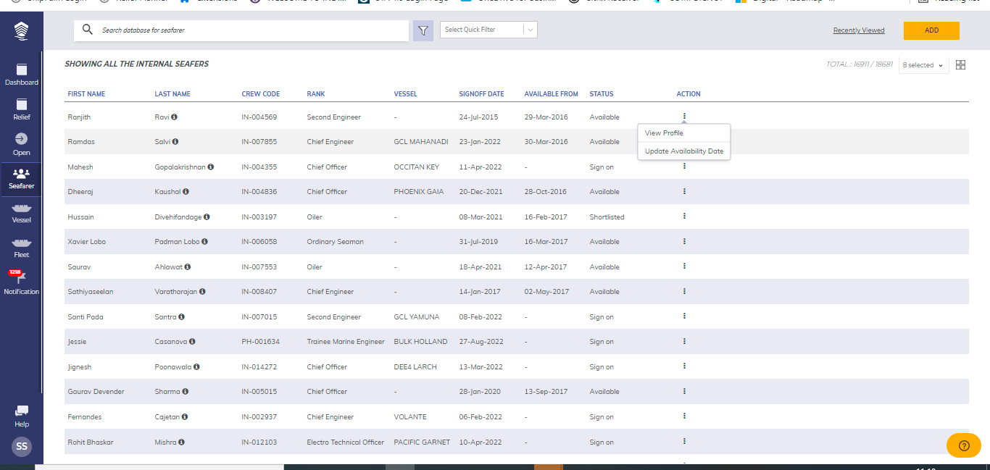
Seafarer app
Search – with rank , Type of ship etc
Update availability , View the profile

Slide 26
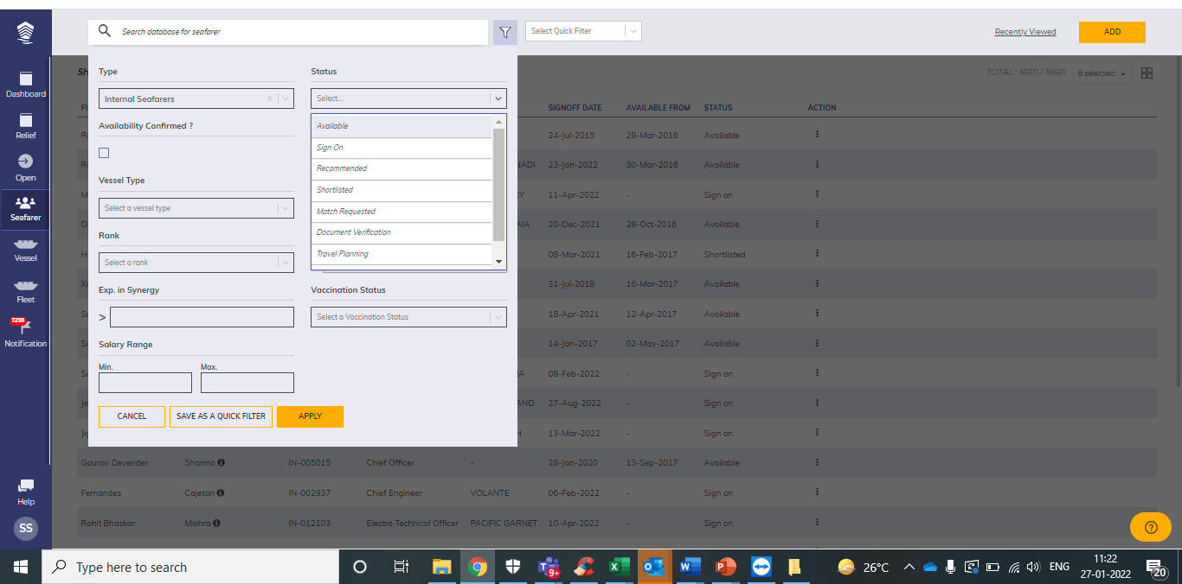
Various status
Status
Registered
Applied
Selected
Match Requested
Matched
Documentation
Travel planning
Sign on
Available

Slide 27
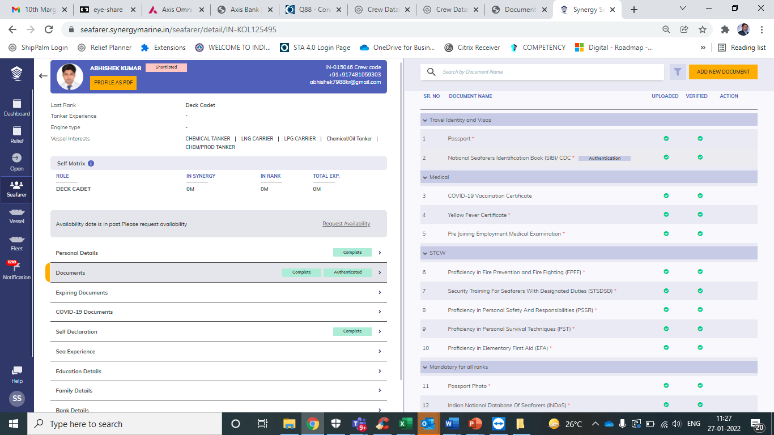
Crew profile page
1.Personal details
2.Documents – STCW, Tanker Docs , In house training , Travel Docs , Flag Docs ,General docs
3. COVID vaccination Details
4. Sea Experience
5. Education details
6. Family Details
7. Bank details
8. Contact Details
9. Experience summary
10 Status

Slide 28
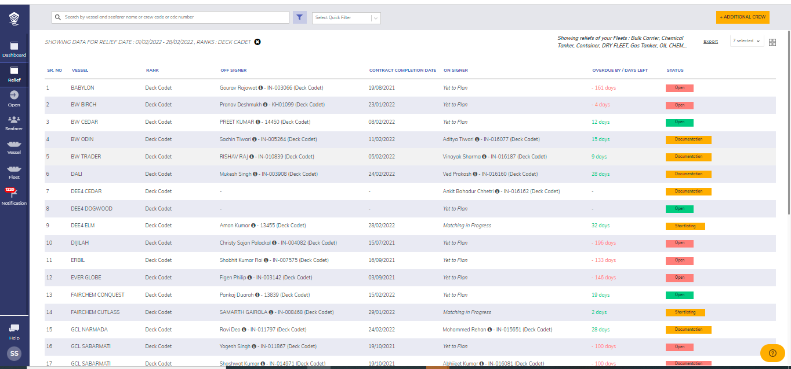
Relief planner App
Can filter rank wise and ship wise
Status – can be Open , Shortlisted, documentation, Travelling Etc

Slide 29
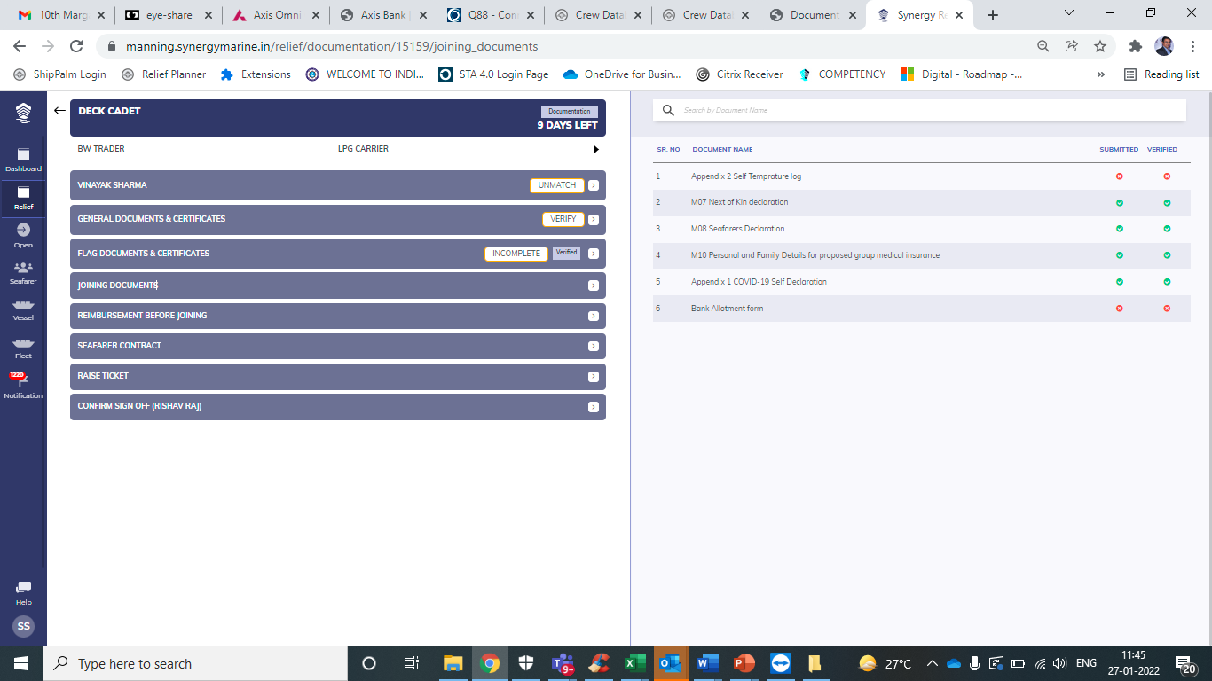
Joining Document section
Check General docs
Check Flag Docs
Joining Document updating
Reimbursement update
Contact generation
Raising Flight ticket

Slide 30
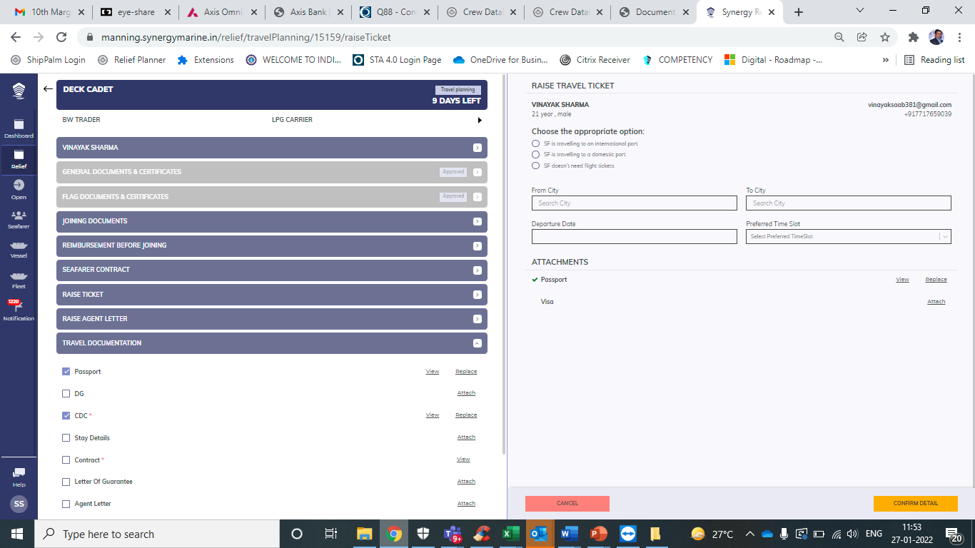
Travel documentation
Push all dos to Seafarer thru Ahoy
Raise ticket
Raise LOG
Attach all required docs so can be seen by seafarer

Slide 31
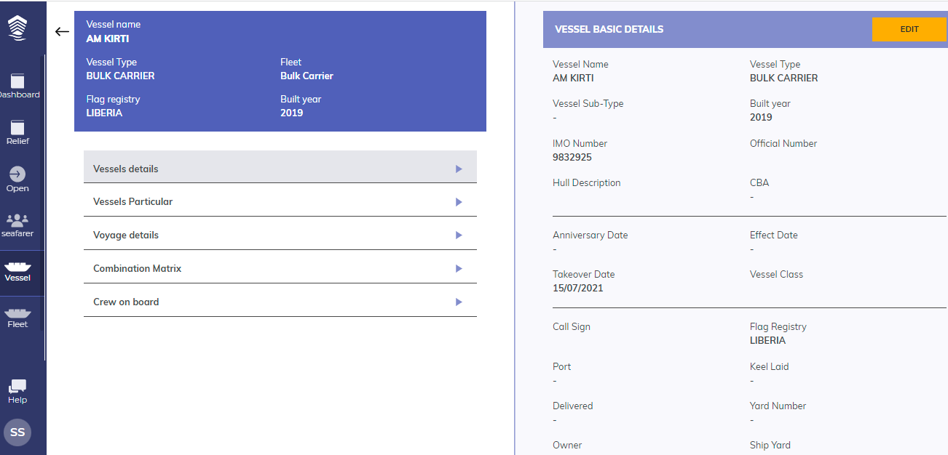
Vessel basic details

Slide 32
Dep Check List and Sign on
All Docs in order
All flag docs uploaded
Contract signed
-- Dep Check List will be activated
- Complete Dep check list – then can sign on and sign off

Slide 33
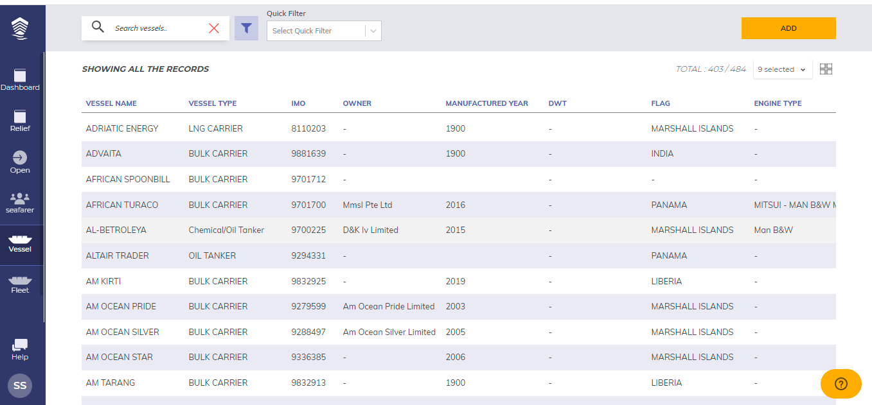
Vessel app

Slide 34
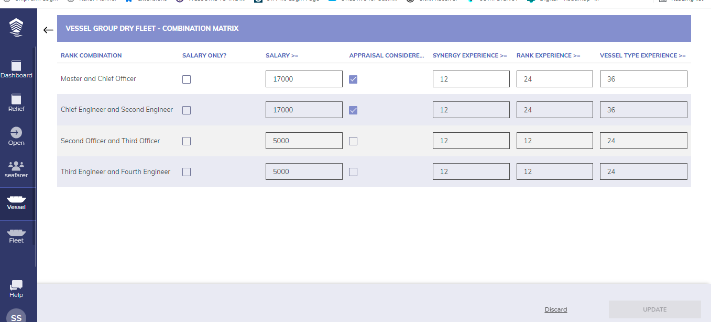
Update combination matrix

Slide 35
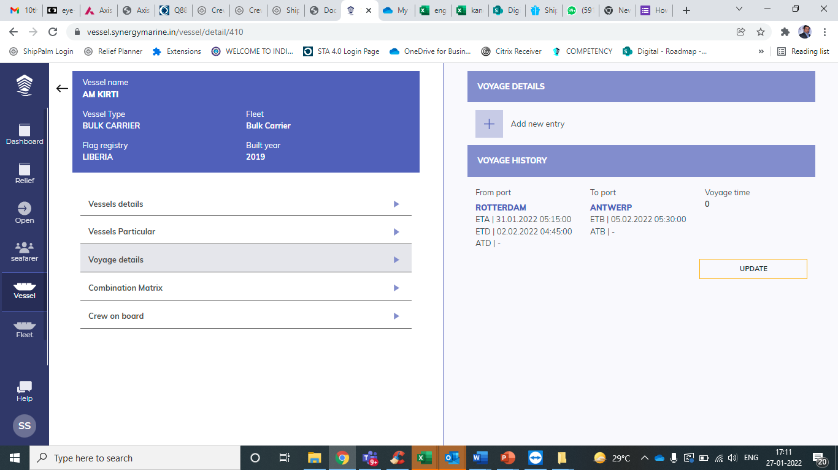
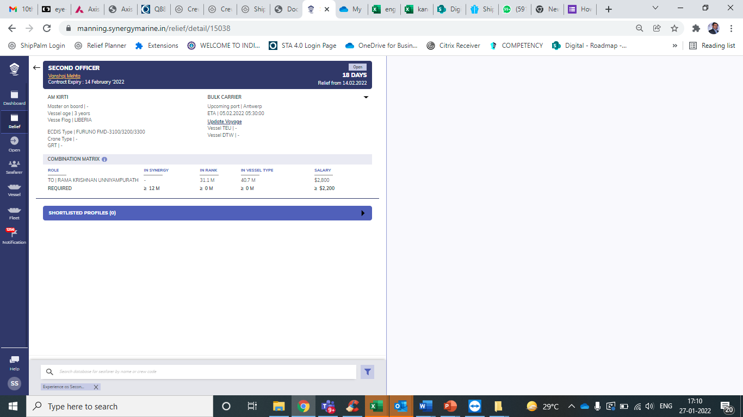
Update vessel schedule– to view in relief planer

Slide 36
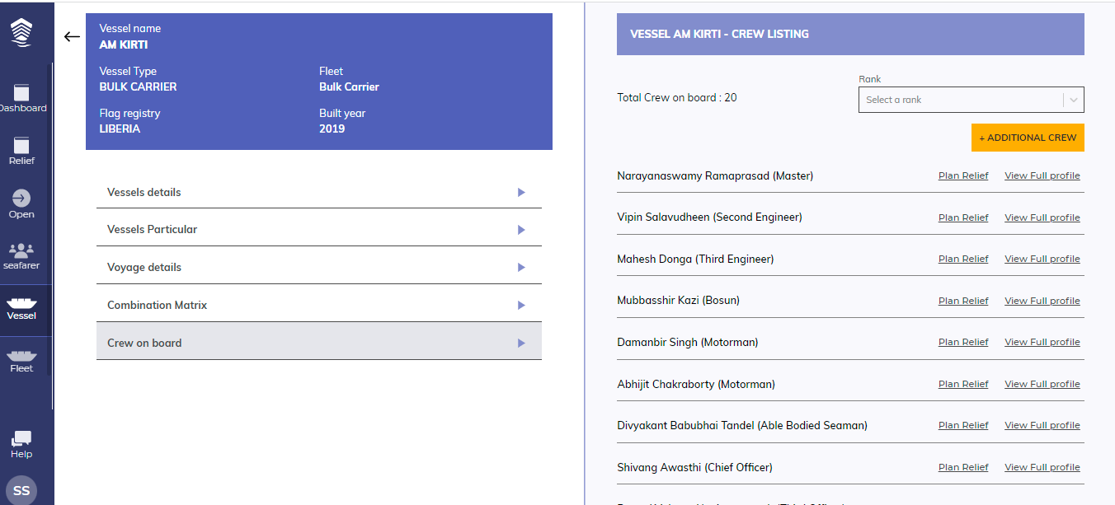
Crew On board List

Slide 37
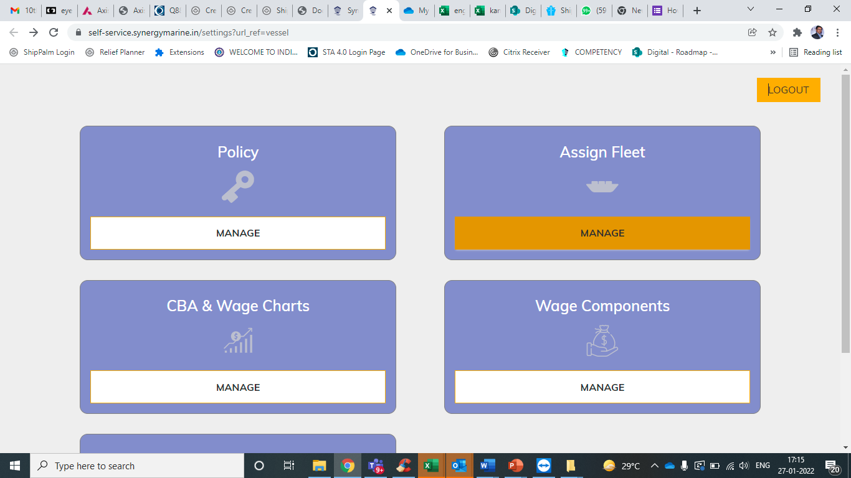
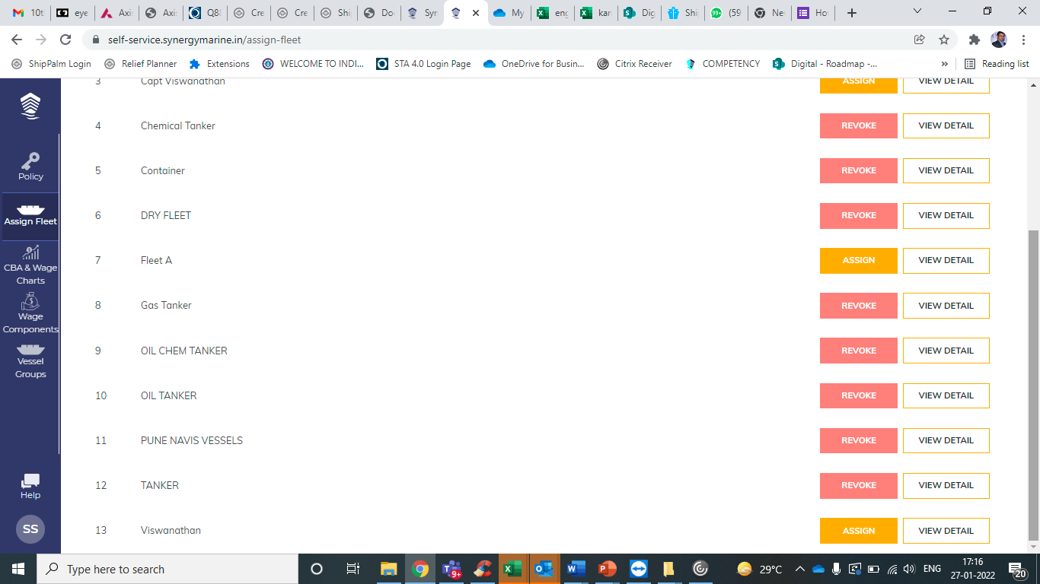
Make your own fleet of vessels to monitor

